Slide 1
UIDAI Hackathon
Team Reference ID : sKMBhJ0gNm
Team Member Details
SI No | Name | E Mail ID
1 | Darin Joshua D | dj2000official@gmail.com
2 | Gladwin Joseph Solomon B | gladwin1508@gmail.com
3 | Joel Nithish Kumar M | joelnithishkumar.m@gmail.com
4 | Isaac G | gisaac1911@gmail.com
5 | Jefferson Clinton B | jeffersonclintonbenny@gmail.com

Slide 2
About the Problem Statement
Theme : Authentication Reimagined
Problem Statement: Airport check-in Web Application
Create an application for smooth check-in experiences
Use Aadhaar Services, without revealing Aadhaar number
The client application will make use of UIDAI face authentication service.
The verifier application may be assumed to have no access to UIDAI servers.
The application should work offline and provide sub-second end-to-end response time

Slide 3
Approach
Our client app is an airport check-in webapp which gets in the data of flights/destination/date and authenticates our data based on their services (API) to help in easy and hassle-free check-in and boarding.
Aadhaar authentication services like KYC and OTP APIs to quickly board into flights sooner and hassle free using the UID/VID (Stage UID: 999997736360).
Just enter your flight/destination/date and authenticate yourself and we will check yours’ & your family details for easy airport check-in and flight onboarding.

Slide 4
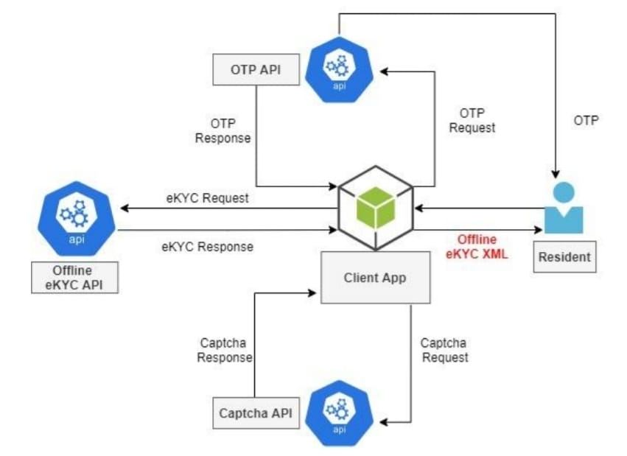
Architectural Diagram

Slide 5
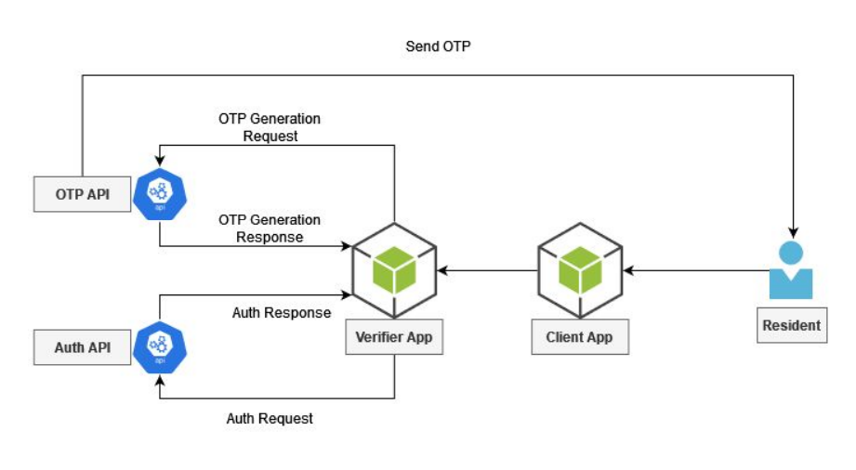
OTP Architecture

Slide 6
API Usage
The Offline and Online KYC API is used to authenticate the details of the passenger and their family based on the Aadhaar Services to speed up the check-in and onboarding process in the airport.
The OTP API is used to authenticate KYC and confirm the Aadhaar details of the passenger.

Slide 7
Security Considerations
Coming to the security of the data, our app needs to be reliable.
To ensure you do security testing for you to be sure that the app can be
relied upon before you launch.
Measures taken for security purpose are
1. Source Code Encryption
2. Understanding all the Store Limitations
3. Secure the Backend
4. Minimize Storage of Sensitive Data

